Slide 1

Teleco Churn Analyzer Using Power Bi
Major Project 2022-2023
Project made under the guidance of :
Prof. Pramila Mate
Associate Professor
Terna Engineering College

Slide 2
Team members
Sahil Sanjiv Bhosale | TU3F1920044
Manoj Dilip Landge | TU3F1920012
Parag Vinayak Bhandari | TU3F1920036
Abhishek Ashok Eitkar | TU3F1920013

Slide 3

Agenda
Abstract
Introduction
Aim and Objective
Scope
Literature Survey
Existing System Limitations
Problem Statement
Proposed System
Methodology
System Design
Technology Stack
Conclusion
References

Slide 4
Abstract
Churners have always been a big issue for any service providing company. Churning increases cost of the company as well as decreases the rate of profit.
The aim of the our project is to analysis the customers past service usage, service performance, spending and other behavior patterns, the likelihood of whether a customer wants to terminate service can be determined .
And predict whether a customer will churn in the near future or not based on the predictive analysis using billing data of a telecom company.

Slide 5
Introduction
Churn analysis is probably one of the most important task for telecom companies . In our project we are going to analyze the telecom customer churn which plays a major factor in the overall profits earned by the company.
we will also predict the customers that are at a high risk of leaving. The overall project we are making in Power BI which is very useful business analytics tool .

Slide 6


Aim & Objectives
To explore the customer churn prediction in telecom using machine learning in big data platform.
To investigate the impact of customer churn in telecom industry as a whole.
To discuss the significance of different tools models for customer churn in telecom industry.
To reduce time complexity for better decisions to bring back customers which are at high risk of loosing services of company.
To develop simple understandable dashboards by the data visualization techniques of different software tools like Power Bi.

Slide 7

Scope
Use of complete dataset to implement churn analysis method.
Properly use data modelling tool to predict the churning.
Implement multiple methods to analyze churn.
Compare different methods to find the optimal one.
Use and compare multiple data visualization techniques.
Use of different dashboards for different by selected parameters.

Slide 8
Literature survey
Year | Author Name | Paper Name | Description
2021 | B.N.Krishna Sai | Predictive Analysis and Modeling of Customer Churn in Telecom using Machine Learning Technique | In this paper , author used random forest algorithm and got 82% accuracy for churn analysis.
2020 | Pushkar Bhuse | Machine Learning Based Telecom-Customer Churn Prediction | In this paper , author used decision tree algorithm and got 80% accuracy in churn prediction.
2019 | Kamil Dimililer | Customer Churn Prediction For Business Intelligence | In this paper , author proposed the model using logistic regression with accuracy of 78% which was able to predict churn and the trends .

Slide 9
Existing system and Limitations
Existing System :
The major contribution of the current study is to present a model of churn prediction that helps telecom companies to find users who are more intending to churn.
The significance of this purpose is apparent, given the reality that the expenditure for acquisition of customer is comparatively higher than that of the retention of customer.
Limitations Of Existing System
In Existing System , the analysis and visualization was very difficult to understand for the clients .
The prediction and analysis was very much time consuming and costly .
It impacts on the overall profit and revenue of company .

Slide 10
Problem Statement
The retention and acquisition of users are the major concerns in telecom industry. The fast growth of marketplace in every business is giving rise to increased subscriber base. It has become necessary for service-providers to reduce the churn rate of customers since the inattention might negatively influence profitability of the company.
Churn prediction contributes to identify those users who are likely to switch a company
over another. Telecom is enduring the problem of ever-increasing churn rate.
Machine learning algorithm techniques facilitate these telecom firms to be protected with
efficient approaches for lessening the rate of churn. It must be the aim of the decision-maker and systems lessen the churn ratio since it is a recognized fact that comparatively existing customers are the most beneficial resources for companies than acquiring new one.

Slide 11
Proposed System
In Proposed System is being made in Power BI tool which is offers the interactive data visualization and analytics tool for business intelligence (BI).
The analysis of data is divided into various dashboards so clients can easily understand the situation of the business .
In this system , we are predicting the customers that are at a high risk of leaving.
In proposed system the aim is to increase the revenue of the company and helps in taking appropriate decision by analyzing the business problems .
Advantages:
Proposed system is user friendly for users and clients.
Accuracy of Proposed system is more than existing system.

Slide 12
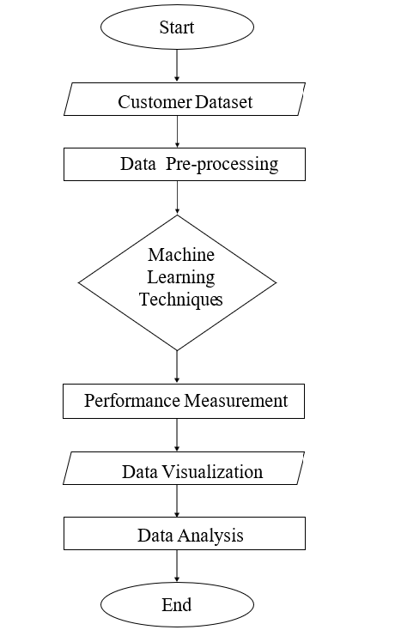
Methodology
Flowchart :

Slide 13
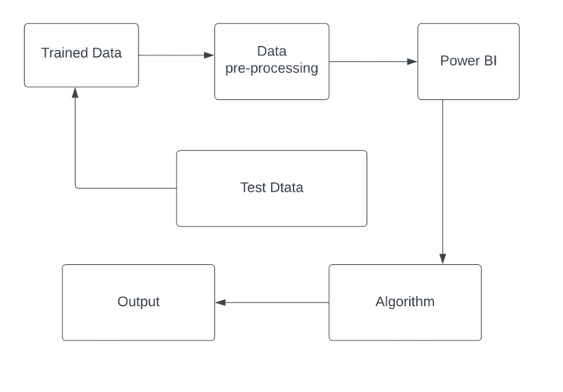
System Design
DFD diagrams :
Data Set
Processing
And
Modelling
Churn Analysis
Figure 1:
Level 0 DFD
Figure 2:
level 1 DFD

Slide 14
Functional And Non-Functional Requirements
Functional Requirement :
Home module
Summary module
Customer Details module
Churn Reasons
Ask Question Module module

Slide 15
Non-Functional Requirements :
Maintainability
Reliability
Availability
Portability
Usability

Slide 16
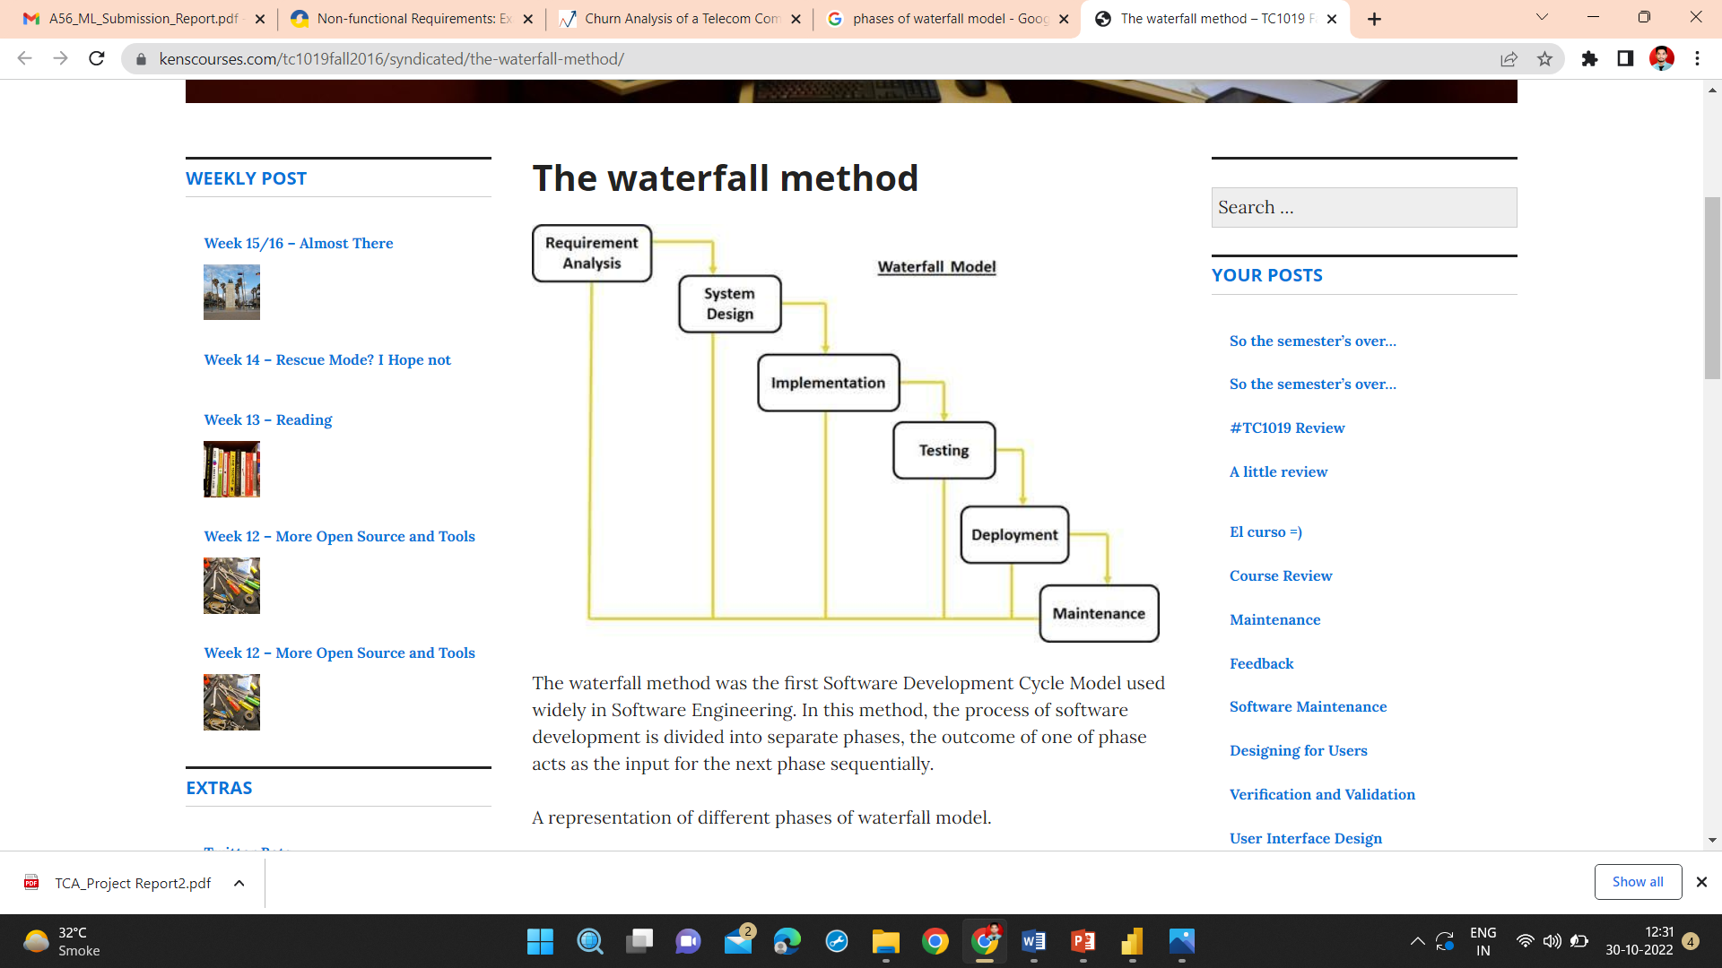
SDLC Waterfall model
Figure 3: SDLC Waterfall model

Slide 17
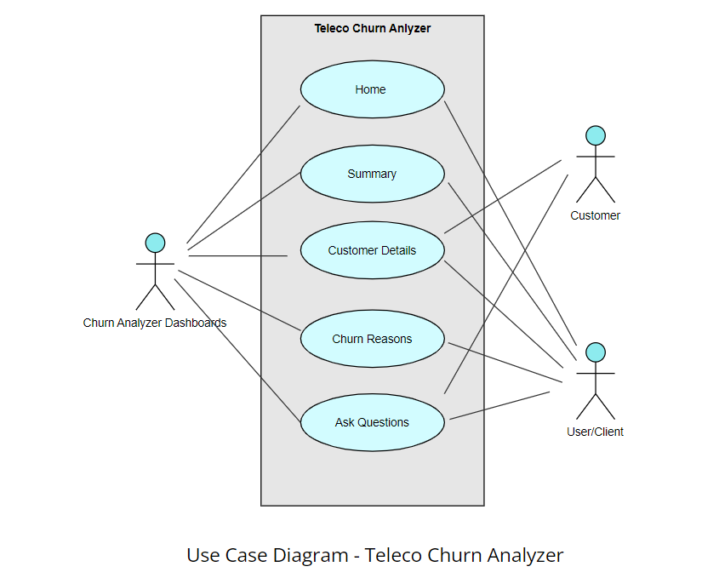
Use Case Diagram
Figure 4: Use Case Diagram

Slide 18
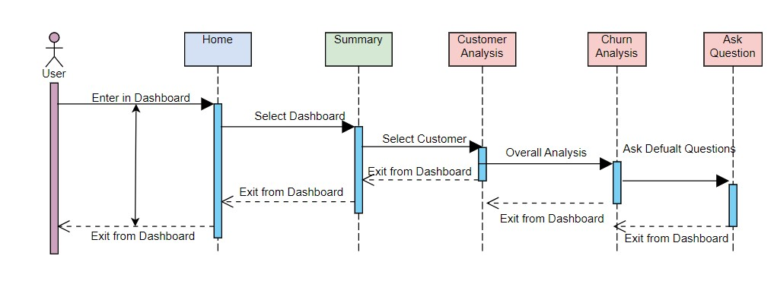
Sequence Diagram
Figure 5: Sequence Diagram

Slide 19
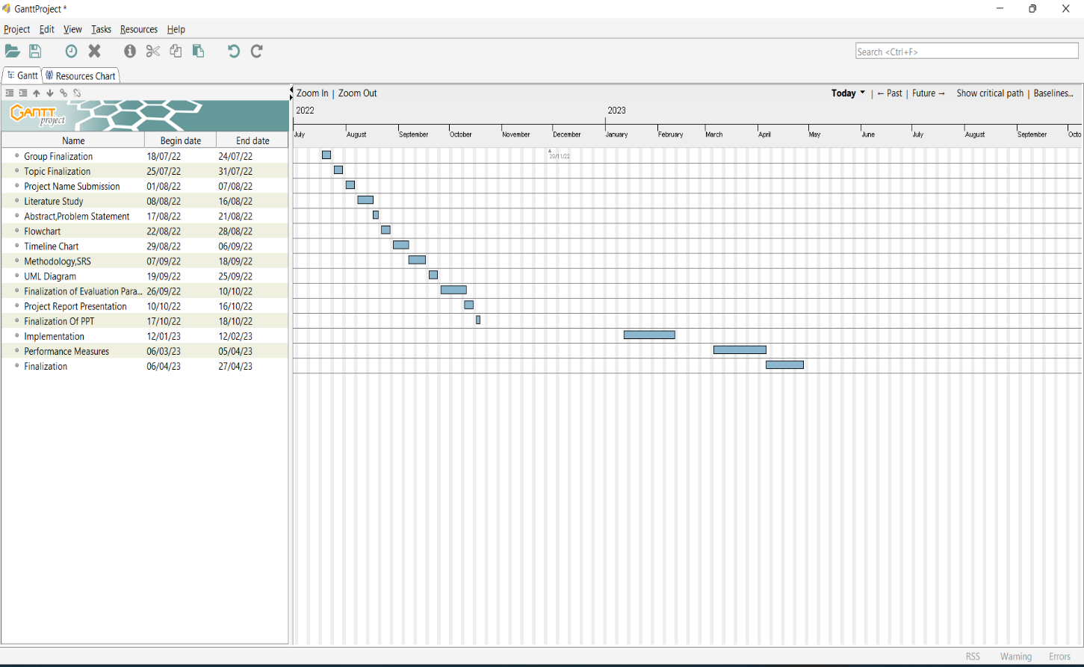
Gantt Chart (Timeline Chart)
Figure 6: Gantt Chart

Slide 20
Technology Stack
Front End : Power BI
Back End : Python
Hardware requirements
Processor: Intel Core I5 , AMD
Processor Speed: 833 MHz
Ram: 4 GB Ram
Hard Disk: 512 GB
Software requirements
Operating System: Windows 7,10,11
Environment: Visual Studio Code
Language: Python

Slide 21
Conclusion
The project is ready with the all system designs and all user requirements have been addressed, and it will be made as user-friendly as possible. And the system is ready for implementation phase.
The Goal of the project is working on the telecom churn analysis and here we will be doing a complete EDA process to determine if the customer from that particular telecom industry will leave that telecom service or not meanwhile we will draw some insights from data visualization and analysis in PowerBi so that we could get the factors which will affect the output i.e. churn of the customer.

Slide 22
References
[1] B.N.Krishna - Predictive Analysis and Modeling of Customer Churn in Telecom using Machine Learning Technique Volume 7 , 81542 - 81554 June 2019
[2] Pushkar Bhuse - Machine Learning Based Telecom-Customer Churn Prediction Dec 2020
[3] Kamil Dimililer - Customer Churn Prediction For Business Intelligence April 2021

